Slide 1
Chemistry
A Study of Matter

Slide 2
Scientific Method
a logical method of problem solving (a step by step process)

Slide 3
Steps of the Scientific Method
Making observations that lead to a question
Forming a hypothesis to answer a question.
Testing the hypothesis by experiments
Making a conclusion based on the results of the experiment.

Slide 4
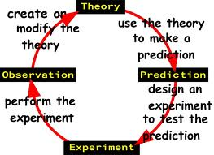
Examples of the Scientific Method

Slide 5
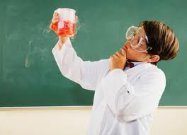
Observing
Use of the senses and devices in the lab to obtain information.

Slide 6
Conclusion
A statement based on observations and on knowledge.

Slide 7
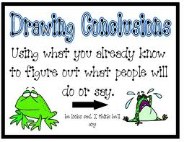
Examples of a Conclusion

Slide 8
Check your understanding
Test your knowledge Of Observation and Conclusion.
Number your paper from 1 to 8
write “ O ” for observation and “ C “ for conclusion

Slide 9
Check your understanding
The milk tastes sour.
The sour milk must be spoiled.
The temperature of the liquid is 33⁰C
The wire must be made of copper because its copper colored and conducts electricity

Slide 10
Check your understanding
It must be about to rain because the sky is getting dark.
When the powder is added to water it fizzed.
The gas blown on the candle must be carbon dioxide because the flame went out.
Lemon Juice is an acid and tastes sour. All acids must taste sour.

Slide 11
Check your understanding
Answer Time!!!
O
C
O
C
C
O
C
C

Slide 12
Observations
There are two types of observations
Quantitative
includes numbers and units(Think Quantity=some amount)
Qualitative
does not include numbers and units
(Think Quality)

Slide 13
Observations
http://youtu.be/8hmF-t2z0Fw
http://youtu.be/jSdxYb2IVwg

Slide 14
Qualitative vs. Quantitative
Number your paper from 1 to 8
Label the sentences L=Qualitative N= Quantitative

Slide 15
Qualitative vs. Quantitative
The candle is white
It’s shaped like a cylinder.
This candle has a diameter of 2.1 centimeters.
The candle material smells like wax.

Slide 16
Qualitative vs. Quantitative
The candle material is soft enough to be scratched by a fingernail.
The candle is lit by holdin flame close to wick
The flame is about 2cm wide and 5cm long.
After the flame goes out the liquid solidifies after five seconds.

Slide 17
Qualitative vs. Quantitative
Answers!!!
L
L
N
L
L
L
N
N

Slide 18
Hypothesis
an educated guess
Example Sentences:
Students should also understand that a theory is broader than a hypothesis .
The police have a hypothesis of their own.
That hypothesis fell into doubt when the chicken hopped the fence and began roaming around our yard.

Slide 19
A Good Hypothesis
Explains an observation
Can be tested
Will predict an outcome

Slide 20
Practice forming a hypothesis
What is the purpose of the candles wick?
As the candle burns it gets shorter. Where does the wax go?
Don’t use I think!
How would you test these?
What type experiment would you design?

Slide 21
An Experiment
Is designed to test the hypothesis
Involves variables
Is preformed under controlled conditions

Slide 22
Variables
Factors that can be changed.
Control: a variable that is held constant.

Slide 23
In a good experiment
Only two variable are allowed to change
The manipulated (or independent) variable is cahnged by the scientist
The responding (or dependant) variable changes as a result of the experiment
All other variables are controls because they are held constant

Slide 24
Questions? Comments?
Test on Friday study these notes! Test on Friday September 16th study these notes!

